Slide 1
IT Security and Penetration Testing
Chapter 9
Hacking Network Devices

Slide 2
Objectives
Identify the vulnerabilities of proxy servers
Identify the vulnerabilities of routers and switches
Identify the vulnerabilities of firewalls
Identify the vulnerabilities of virtual private networks (VPNs)
Computer Security and Penetration Testing

Slide 3
Proxy Servers
Perform the following functions
  Restrict users from accessing specific Web sites using Internet access rules
  Mask the IP of the users’ PCs within the network from outside connections
  Maintain logs of the requests and the details of users that are accessing the Internet
  Maintain a cache of the sites that users on the network have visited
Computer Security and Penetration Testing

Slide 4
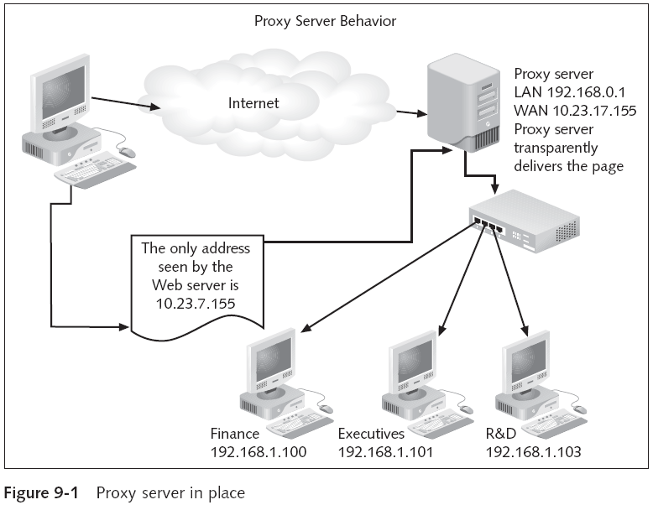
Computer Security and Penetration Testing

Slide 5
Proxy Servers (continued)
A proxy server is simple to install
  It is often part of the operating system of a server
A proxy server is simple to use
  And is often included in router and firewall software
The user interacting via the proxy server is hidden
  But can be traced through the log stored on the proxy server
Computer Security and Penetration Testing

Slide 6
Categories of Attacks
Attacks groups:
  Attacks made upon proxy servers
  Attacks made through proxy servers
Attacks made through proxy servers include
  Buffer overflow attacks
  Denial-of-service attacks
  Session-hijacking attacks
Computer Security and Penetration Testing

Slide 7
Categories of Attacks (continued)
Concealed identity
  Proxy servers hide a user’s real identity
  Hackers use this model to perform hacking operations anonymously
  Hacker’s IP and time of attack is, however, maintained on the proxy server
  Two ways to avoid this logging problem
    Hacker might use a chain of proxy servers
    Hacker can spoof the valid authentication details of a network
Computer Security and Penetration Testing

Slide 8
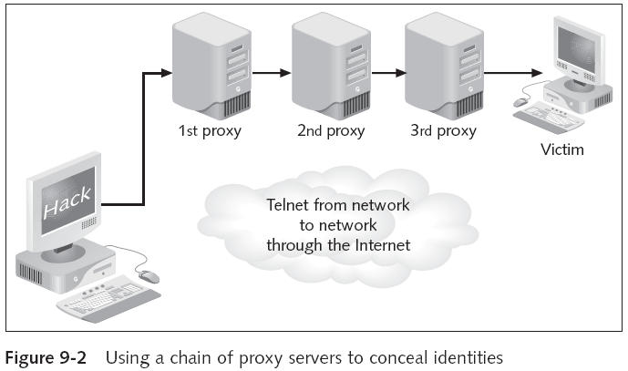
Categories of Attacks (continued)
Computer Security and Penetration Testing

Slide 9
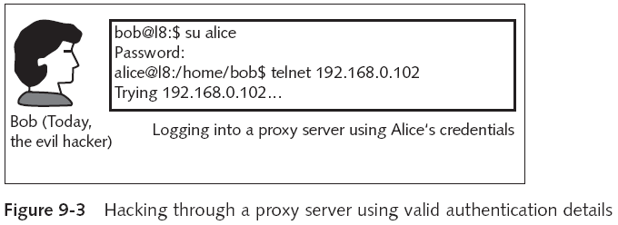
Categories of Attacks (continued)
Computer Security and Penetration Testing

Slide 10
Routers and Switches
Routers and switches both segment a network
  And most can filter packets
Switches are considered to have lower security than routers
Switches are often viewed as internal network components
  With the advent of VLAN technology on switches
    Some networks are being designed with gateway switches
VLANs are a form of logical network segmentation
Computer Security and Penetration Testing

Slide 11
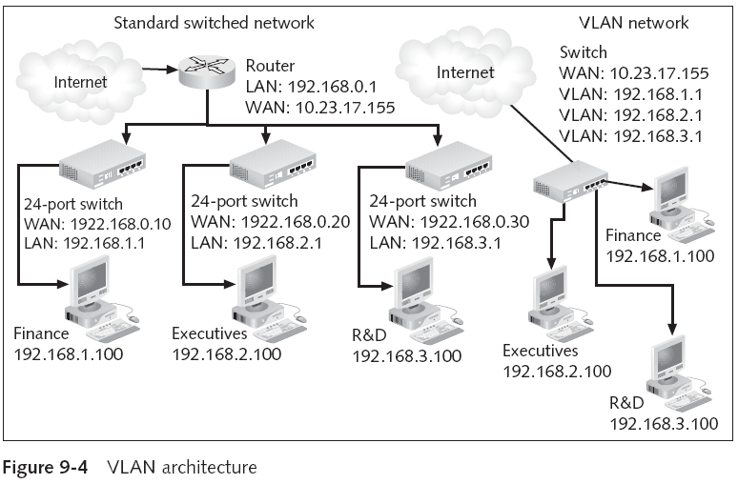
Routers and Switches (continued)
Computer Security and Penetration Testing

Slide 12
Attacks on Routers and Switches
If the attacker has access to the console port of the router
  He can easily set a remote user for the router or switch
Configuration Procedure example
  Passwords are configured for users attempting to connect to the router on the VTY lines using Telnet
Default password for Cisco routers is admin/admin
  See Table 9-1
Computer Security and Penetration Testing

Slide 13
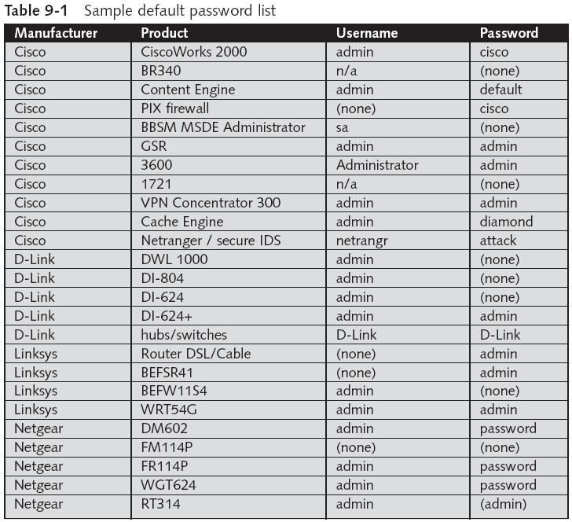
Computer Security and Penetration Testing

Slide 14
Router Exploits
Port scans are used to discover whether ports are open, what applications are using the ports
  And even the operating system of the system being scanned
Hackers can perform many attacks on routers and switches remotely
Some basic router attacks
  Denial-of-Service (DoS) Attack
  Distributed Denial-of-Service (DDoS) Attack
  Route Table Modification Attack
Computer Security and Penetration Testing

Slide 15
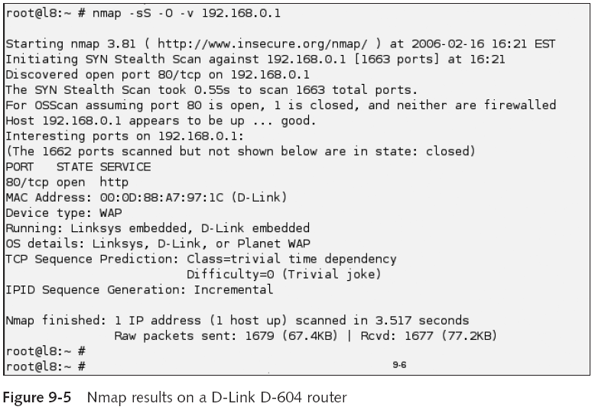
Computer Security and Penetration Testing

Slide 16
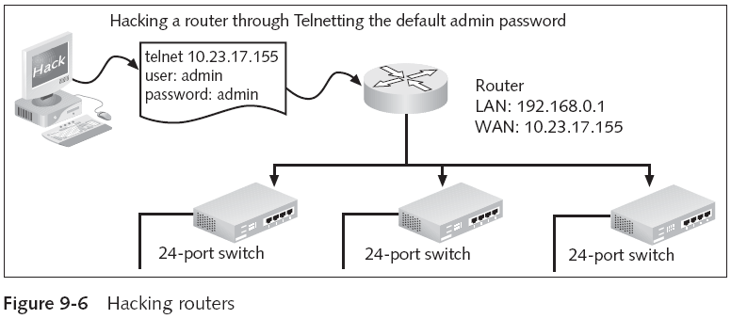
Router Exploits (continued)
Computer Security and Penetration Testing

Slide 17
Firewalls
Often considered the ultimate one-point solution for securing networks
  From both internal and external threats
Main function of a firewall
  Centralize access control for the network by keeping an eye on both inbound and outbound traffic
  Preventing unauthorized users and malicious code from entering a network
Some firewalls can filter the packets on the application layer
Computer Security and Penetration Testing

Slide 18
Firewalls (continued)
Firewalls are designed to be transparent to authorized network users
  And very intrusive to unauthorized users
Computer Security and Penetration Testing

Slide 19
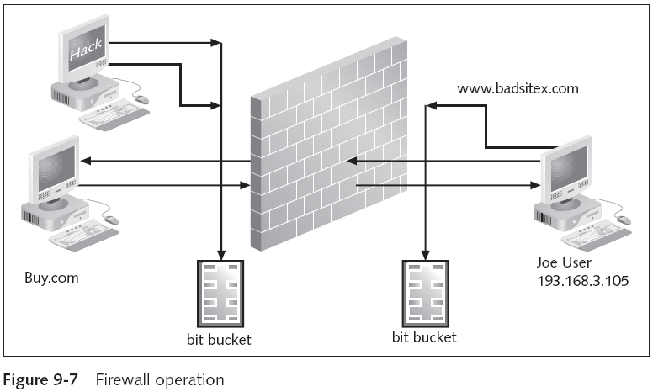
Firewalls (continued)
Computer Security and Penetration Testing

Slide 20
Limitations of Firewalls
Limitations
  Firewalls have a limited ability to check data integrity
  Firewalls cannot filter packets that are not sent through them
  Firewalls from different vendors may not work well together
  Firewalls do not provide robust support for application security
  Firewalls do not provide a complete solution for stopping malicious code from entering a network
Computer Security and Penetration Testing

Slide 21
Limitations of Firewalls (continued)
Limitations (continued)
  Firewalls may not detect attacks if they are not configured properly
  Firewalls cannot detect hackers using a valid username and password
  Firewalls are effective only if security policies are established and enforced
Computer Security and Penetration Testing

Slide 22
Types and Methods of Firewall Attacks
Firewall attacks can be organized into three categories
  Spoofing
  Session hijacking
  Denial of service
Three basic methods to hack a firewall:
  Back doors
  Root access
  Through the Web
Computer Security and Penetration Testing

Slide 23
Types and Methods of Firewall Attacks (continued)
Back doors
  An alternate method used by hackers to access a network
  After an attack, a hacker may leave an alternate route that can be used to hack the network again
  Two ways to restore a computer after an attack:
    Format the computer and reinstall the data
    Fix the bug used by the hacker to access the computer
  Using various techniques, a hacker can lure or fool a user into creating a back door
Computer Security and Penetration Testing

Slide 24
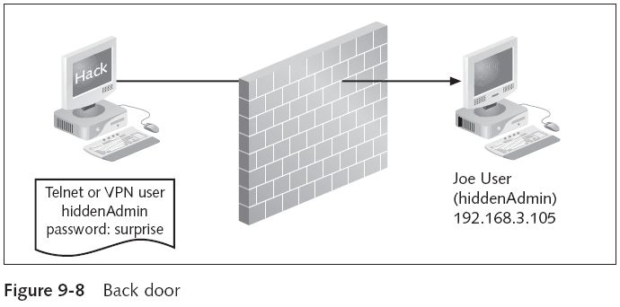
Types and Methods of Firewall Attacks (continued)
Computer Security and Penetration Testing

Slide 25
Types and Methods of Firewall Attacks (continued)
Root access
  Used when hackers want to return to a network and manipulate its data
    By using root or administrative access
  Hacker attempts to gain this access by either using a back door to sniff the passwords
    Or by using some other programming code to hijack a session
  Hacker installs a rootkit that is used for a variety of purposes
Computer Security and Penetration Testing

Slide 26
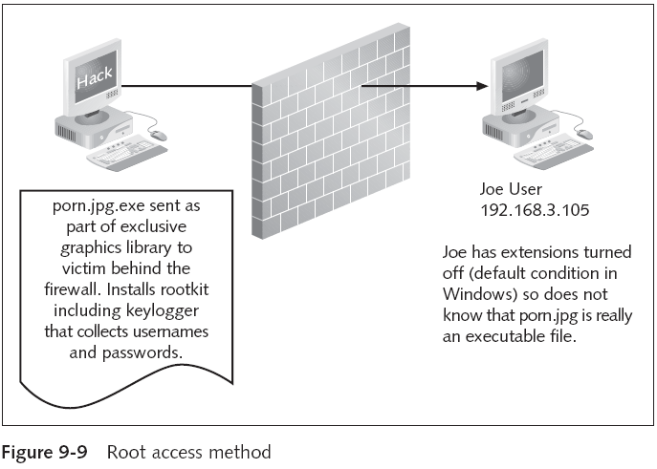
Types and Methods of Firewall Attacks (continued)
Computer Security and Penetration Testing

Slide 27
Types and Methods of Firewall Attacks (continued)
Through the Web
  Hacker can break into a firewall through the Web in many ways
    Since the majority of firewalls permit access to remote Web servers
  Search engines can be used to find information about particular firewalls
A firewall should be considered one piece of the multitier security solution for your organization
Computer Security and Penetration Testing

Slide 28
VPNs
Virtual private network (VPN)
  Allows employees to access their company’s network from a remote location
    Using the Internet as a transport vehicle
  VPN uses protocols like point-to-point tunneling (encrypted data tunneling)
    To send and receive information over the network
Computer Security and Penetration Testing

Slide 29
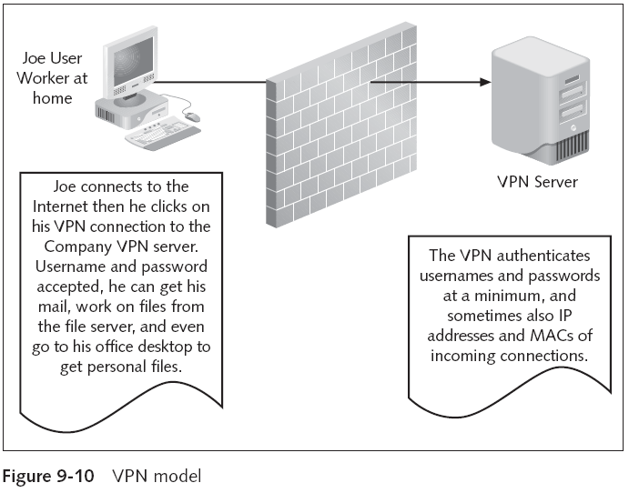
Computer Security and Penetration Testing

Slide 30
Threats through VPN
Attacks on a company’s network through a VPN are often indirect
  And a result of successfully hacking a remote user’s computer
If a VPN connection is sometimes used on the compromised computer
  The hacker can acquire the necessary information
Computer Security and Penetration Testing

Slide 31
Threats through VPN (continued)
A VPN connection of a valid user can be used to perform many attacks on a network, including
  DoS, session hijacking, and spoofing
Computer Security and Penetration Testing

Slide 32
Ways to Safeguard the Network from Attacks through VPNs
Basic steps for safeguarding the VPN links
  Protect your home computer’s physical environment
  Do not use the “save” function for VPN passwords
  Install a host-based (personal) firewall on the remote computer
  Install a host-based intrusion detection system (IDS) on the remote computer
Computer Security and Penetration Testing

Slide 33
Ways to Safeguard the Network from Attacks through VPNs (continued)
Basic steps for safeguarding the VPN links (continued)
  Install antivirus software
  Perform more than one level of security checks
  Audit the personal computers of remote users
  Require username/password entry to remote computers
Computer Security and Penetration Testing

Slide 34
Summary
Network devices like proxy servers, routers, switches, firewalls, and VPNs are often targeted by attackers
Networking software can be divided into three categories: security software, connection software, and transport software
Networking devices allow the computers on a network to interact with each other
Proxy servers restrict users from accessing specific Web sites
Computer Security and Penetration Testing

Slide 35
Summary (continued)
Attacks made through proxy servers include buffer overflow attacks, denial-of-service attacks, and session-hijacking attacks
Routers and switches are used to segment a network
If a hacker has access to the console port of the router, he can easily set a remote user for the router or switch
Attacks made on routers include DoS attacks, DDoS attacks, and route table modification
Firewalls centralize access control for the network
Computer Security and Penetration Testing

Slide 36
Summary (continued)
Firewall have several liabilities
Types of firewall attacks include spoofing, session hijacking, and denial-of-service (DoS) attacks
Firewall hacking methods include back doors, root access, and Web access
Virtual private networks (VPNs) allow users to securely access their network from a remote location through the Internet
Threats through VPN are considered indirect attacks
Computer Security and Penetration Testing

